Slide 1
React App
GAMEGRID
GAMEGRID
By: Loveleen Goyal
2110992021
G19

Slide 2
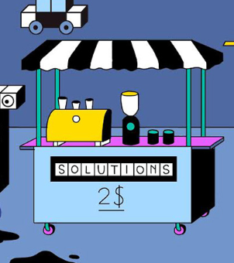
introducing
GAMEGRID
GameGrid is an exciting React web application that brings together classic games like Tic-Tac-Toe, Rock-Paper-Scissors, and Snake on a single platform. Whether you're a fan of strategy, quick thinking, or classic arcade action, GameGrid has something for everyone.

Slide 3
OBJECTIVE
The objective of the Game Grid app is to provide a diverse and engaging platform for users to enjoy classic games such as Tic-Tac-Toe, Rock-Paper-Scissors, Snake, and more. Our goal is to create an immersive gaming experience that offers entertainment, challenges, and opportunities for social interaction.
FUTURE ADVANCEMENTS
We aim to deliver a user-friendly interface, seamless gameplay, and future enhancements, including game tips and interesting facts, to make gaming more enjoyable and informative.

Slide 4



Technologies
ReactJs
USED
JavaScript
TailwindCss

Slide 5
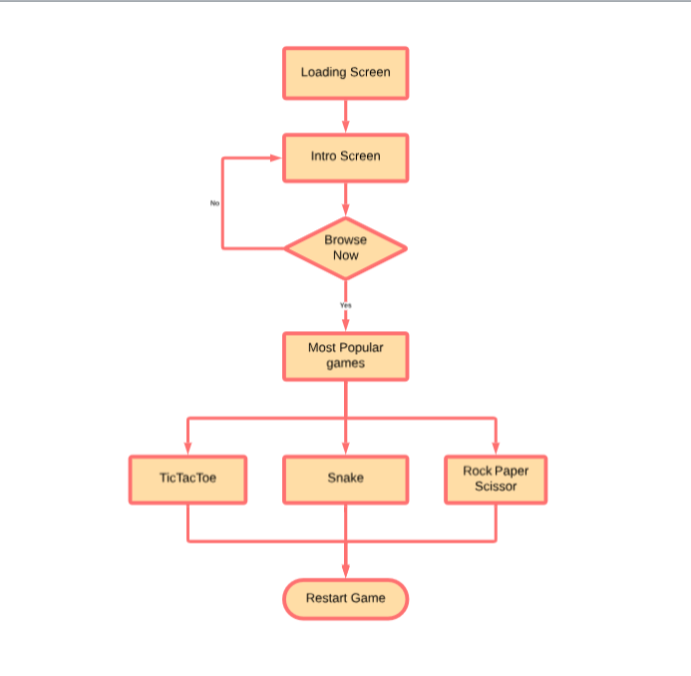
FLOWCHART

Slide 6

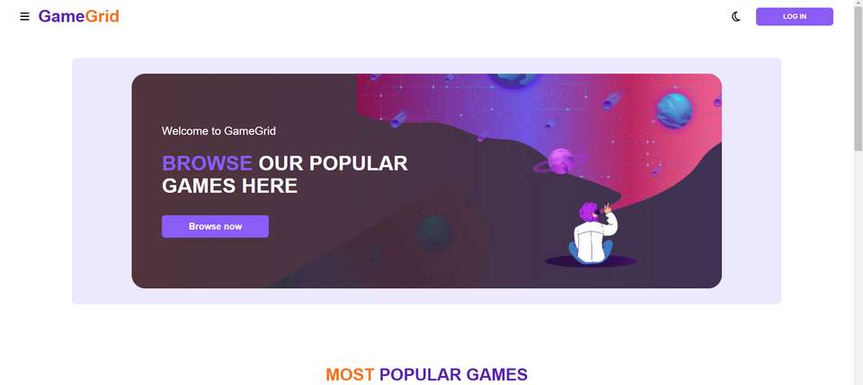
SCREENSHOTS
Loader page
When the GameGrid app is launched or when switching between games or sections, a loader page is shown. It displays a message like "Loader gif "to inform users that the app is preparing to display content.
Homepage
After the loader page component the main content of homepage is shown

Slide 7
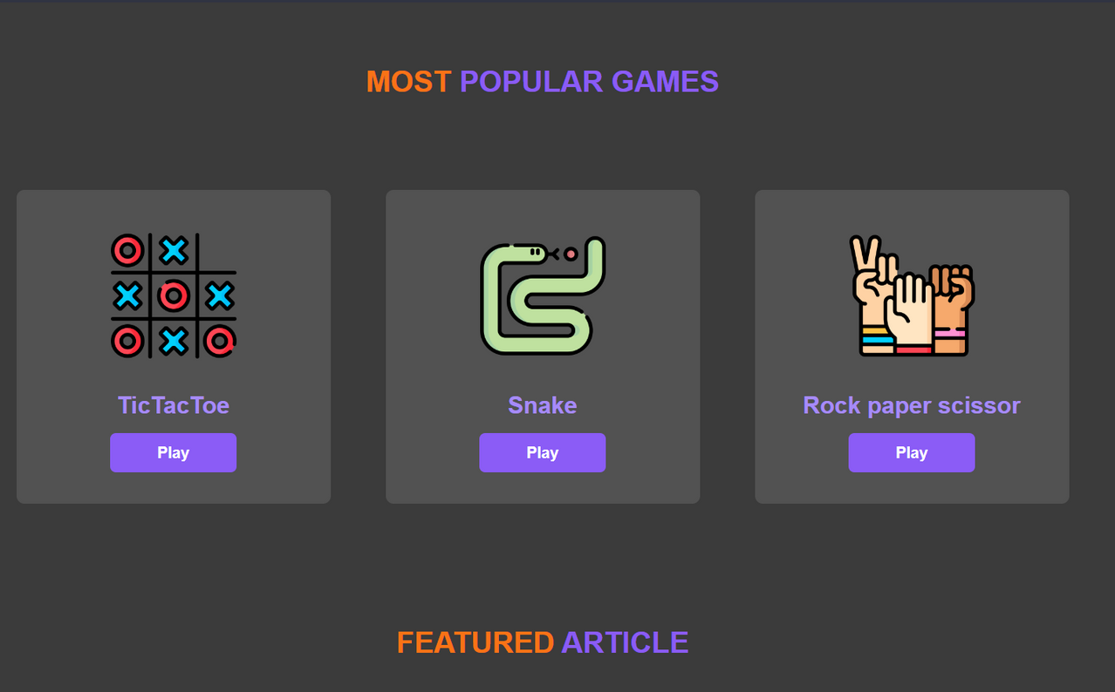
THEME
The app typically includes a toggle switch in the settings or as part of the user profile. Users can switch between the dark and light themes by toggling this option.

Slide 8
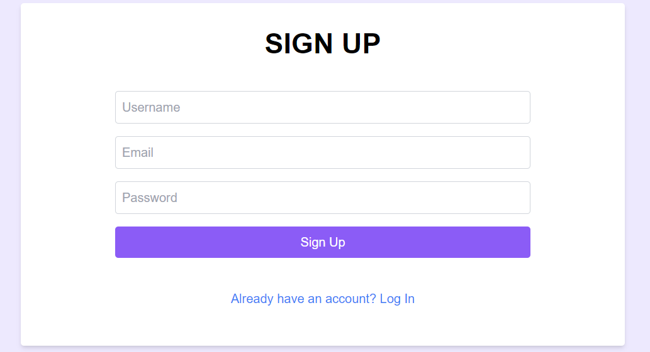
User
AUTHENTICATION
Login
Registered users can log in by entering their email and password.
Sign Up
Users who are new to the app can register by providing essential information, typically including an email address, username, and password.

Slide 9
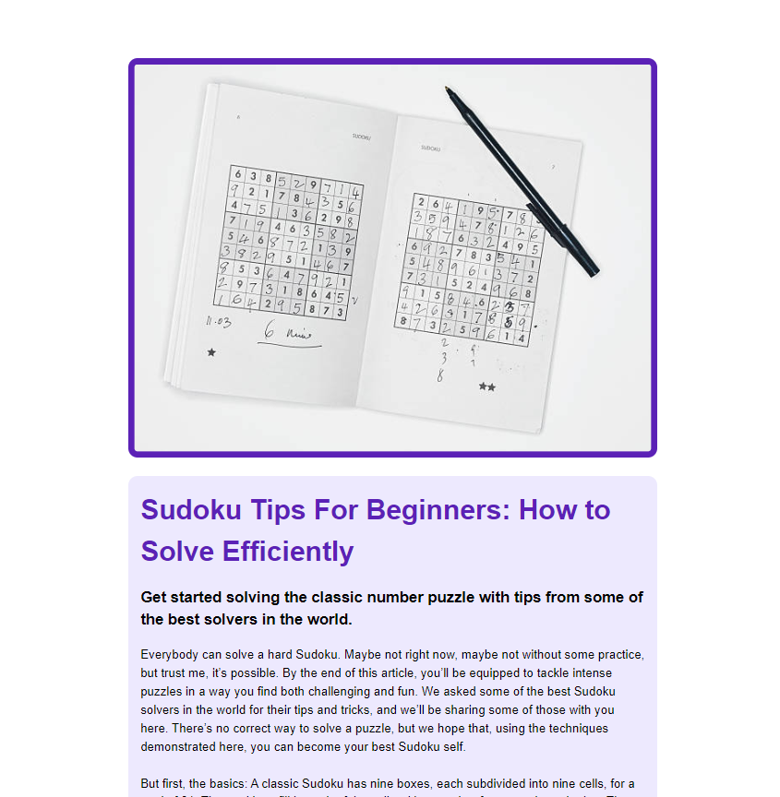
FEATURED ARTICLE
Before diving into any game on GameGrid, make sure you thoroughly understand the rules. Each game has its unique mechanics, objectives, and winning conditions. Familiarity with the rules is the foundation of your success.

Slide 10
THANK
YOU

